Slide 1


Team 20 Presentation
Credit Hours System
Cairo University
PRESENTED BY:
YOUSSEF ALAA MOSTAFA 1180092
MOHAMED KHALED SHAMS 1180552
MOSTAFA MOHAMED SABRY 1162211
MUSTAFA KHALED ABD AL-BARR 1180126

Slide 2
Agenda
Business Part
Problem Description
Dataset Description
Data Insights
Technical Part
Pipeline
Data Preprocessing

Slide 3

Problem Description

Slide 4


Market Basket Analysis and Customer Segmentation
FPGrowth
RFM Analysis

Slide 5

Dataset Description

Slide 6
Dataset Columns
Invoice
StockCode
Description
Quantity
InvoiceDate
Price
Customer ID
Country

Slide 7

Data Insights

Slide 8
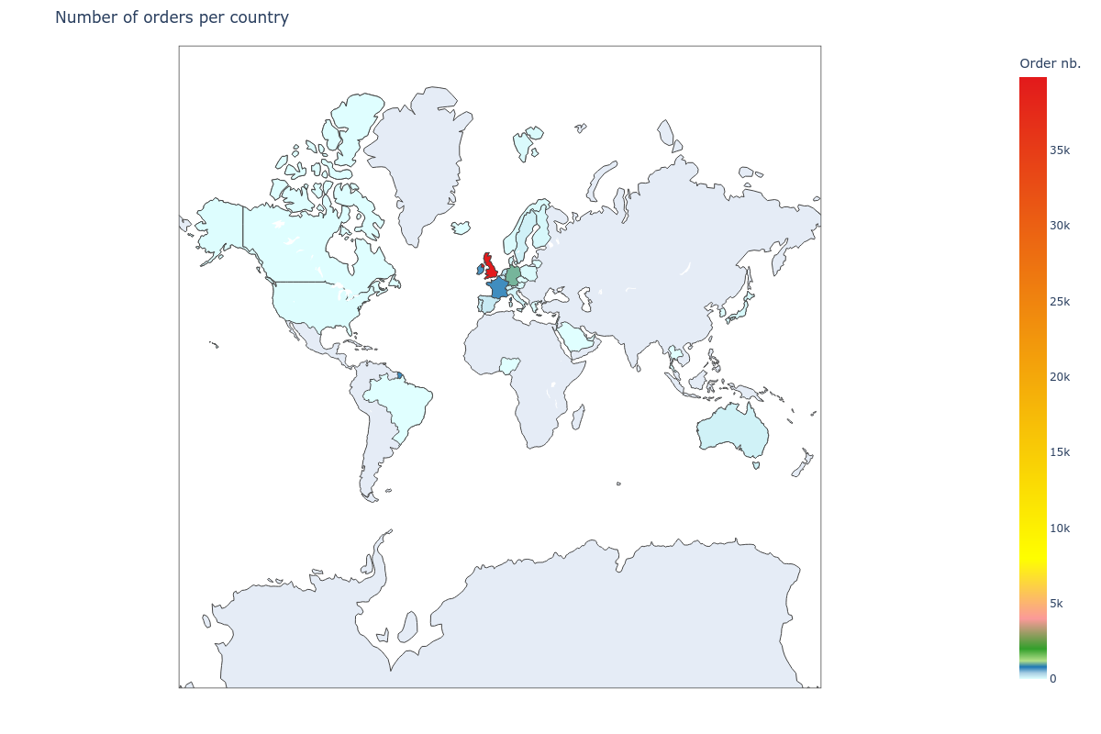
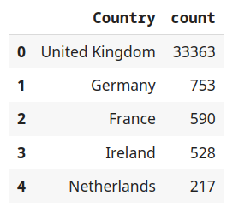
Number of orders per country

Slide 9
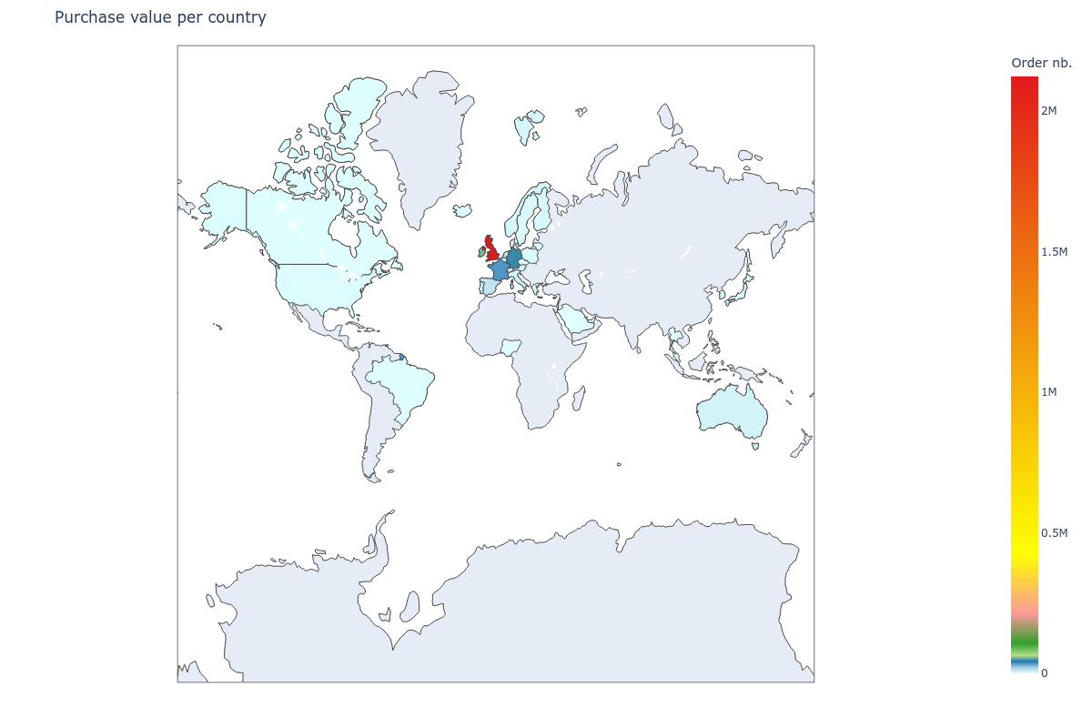
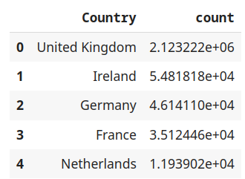
Total purchase value per country

Slide 10
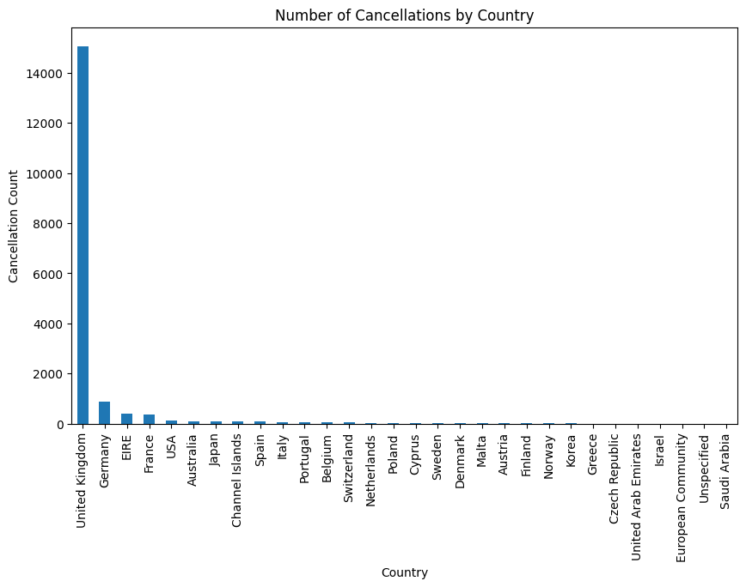
Number of Cancellations by Country
16.6% Cancellation Invoices
percentage

Slide 11
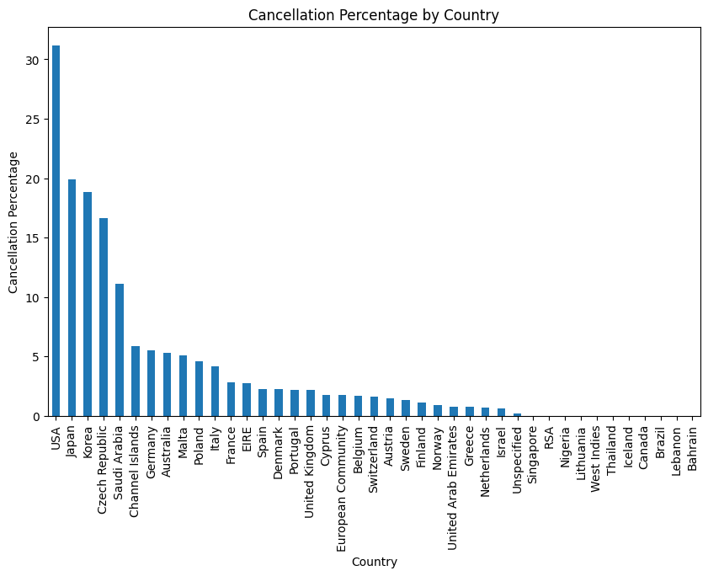
Cancellation Percentage by Country

Slide 12
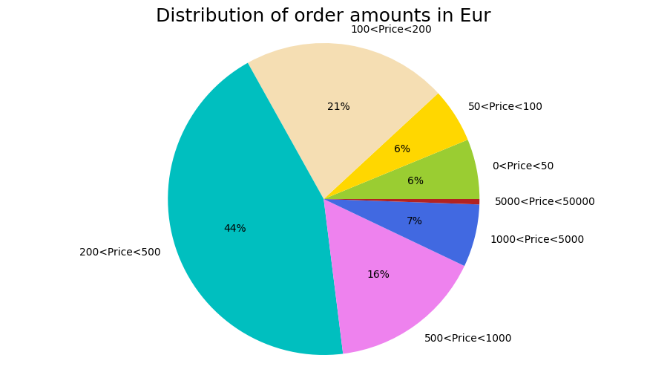
Distribution of Order Prices in EUR

Slide 13
Distribution of Order Prices in EUR

Slide 14
Market Basket Analysis

Slide 15
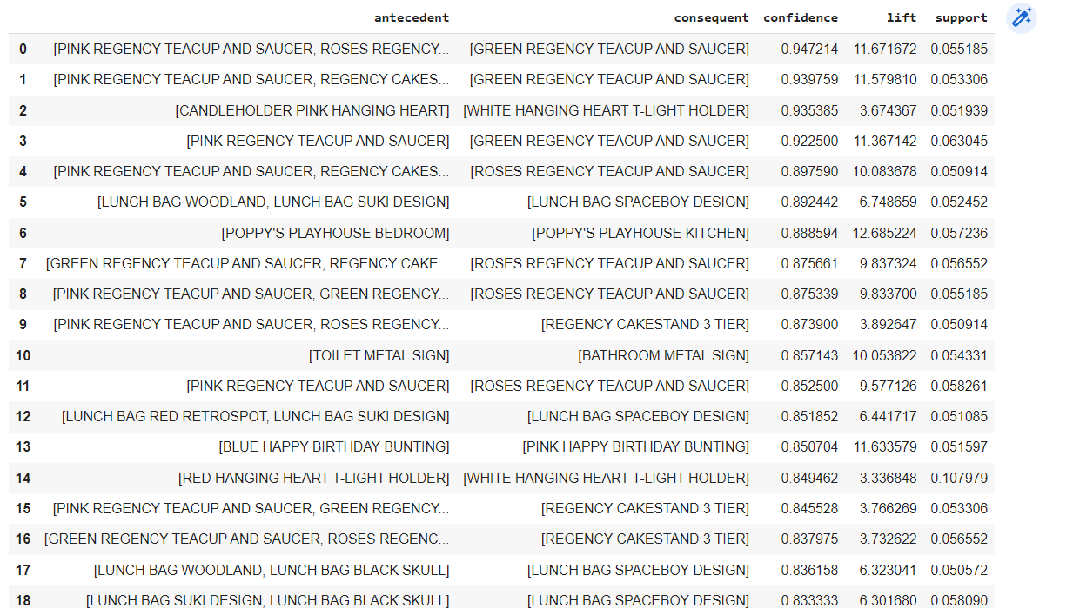
Association Rules for all countries

Slide 16
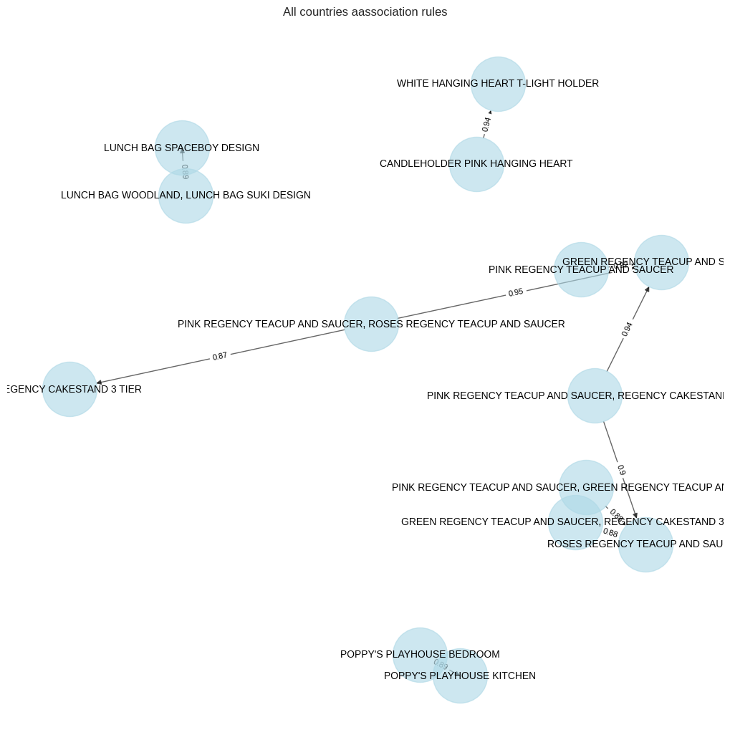
Association Rules
for all countries

Slide 17
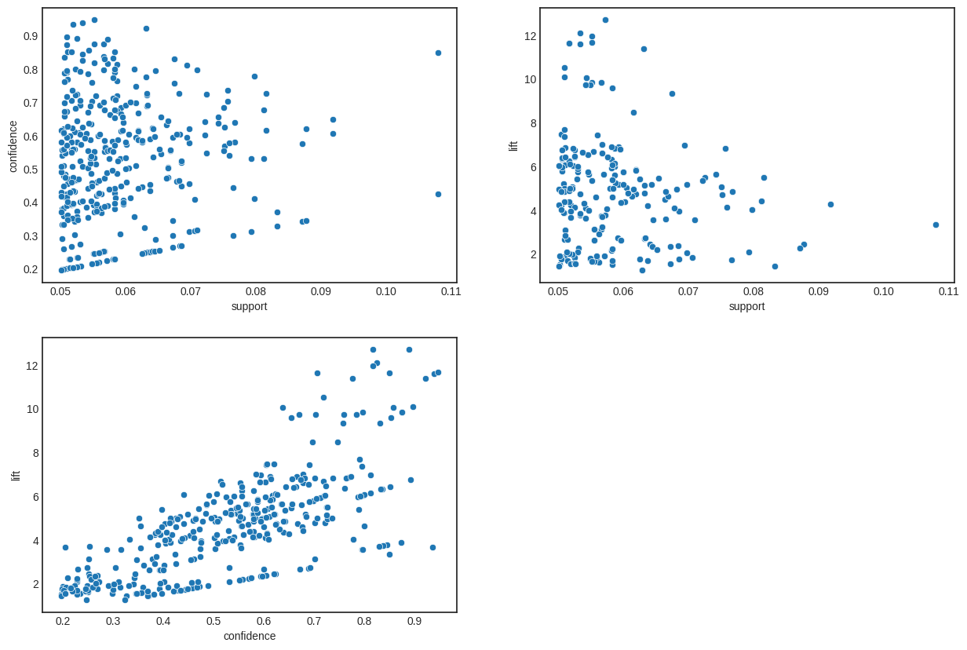
Association Rules
for all countries

Slide 18
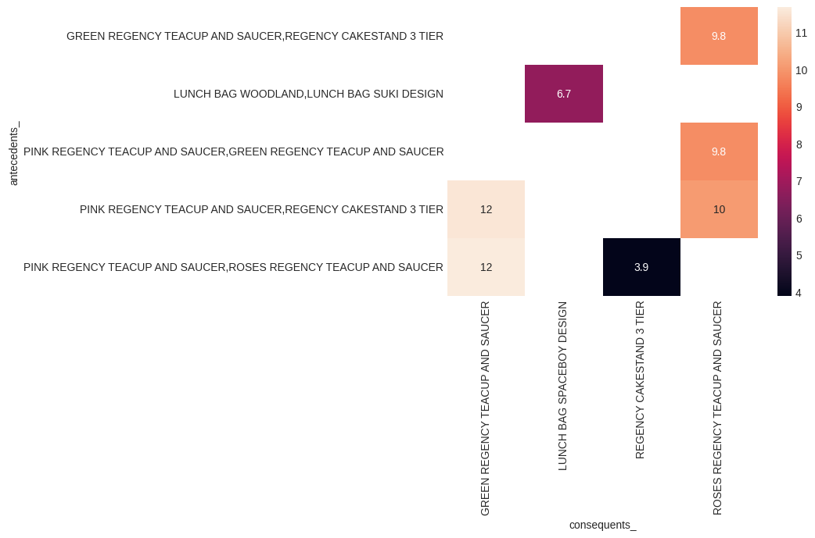
Association Rules
for all countries

Slide 19
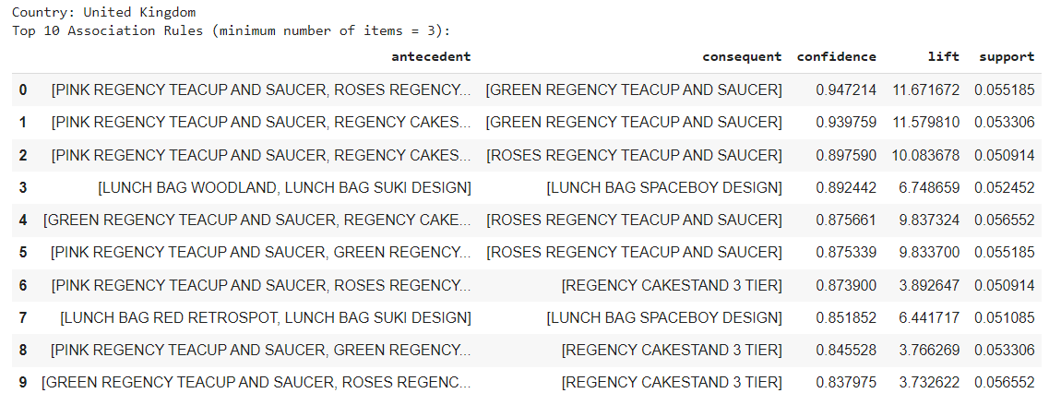
Association Rules For UK

Slide 20
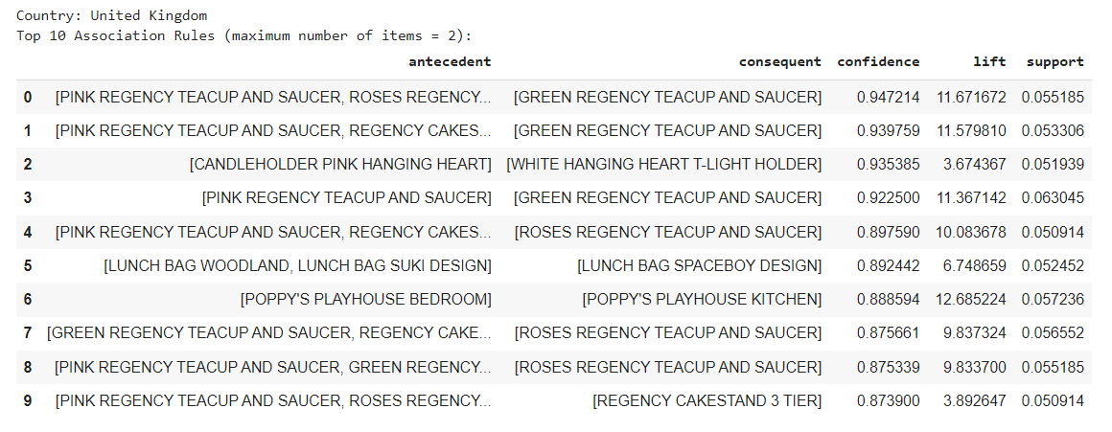
Association Rules For UK

Slide 21
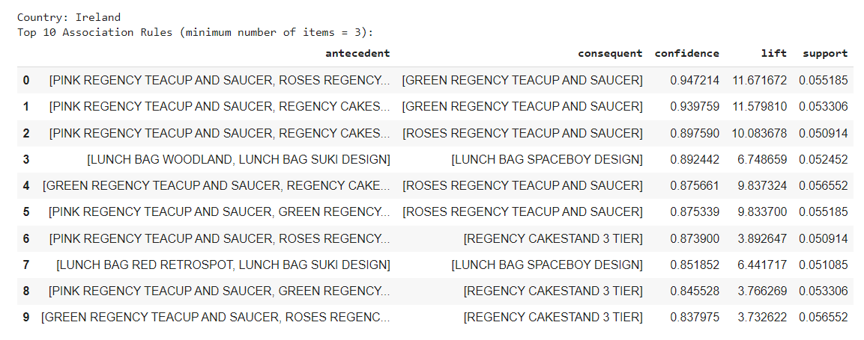
Association Rules For Ireland

Slide 22

Association Rules For Ireland

Slide 23
Association Rules For Ireland

Slide 24
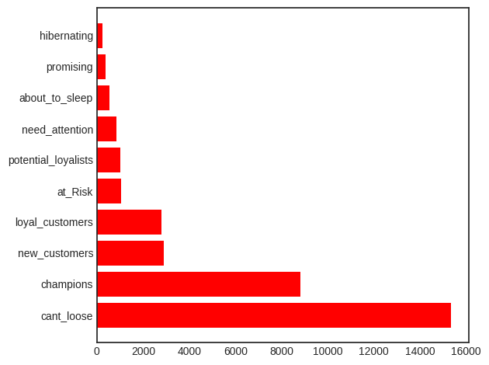
RFM Analysis

Slide 25

RFM Analysis

Slide 26
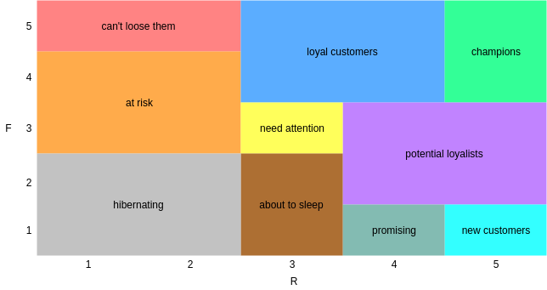
RFM Analysis

Slide 27
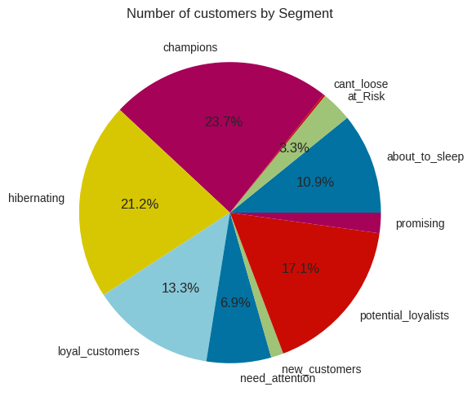
RFM Analysis

Slide 28
Data Preprocessing

Slide 29
Identifying Irrelevant Columns

Slide 30
Data Cleaning
32907 Duplicate rows
243007 NA Customer values
4382 NA Description Values
16.6% Cancellation Invoices
3662 non-number Invoice Values

Slide 31
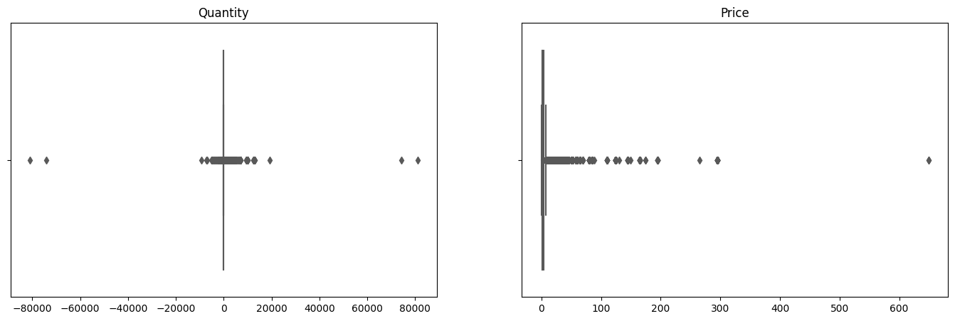

Dealing with Outliers

Slide 32
MapReduce

Slide 33
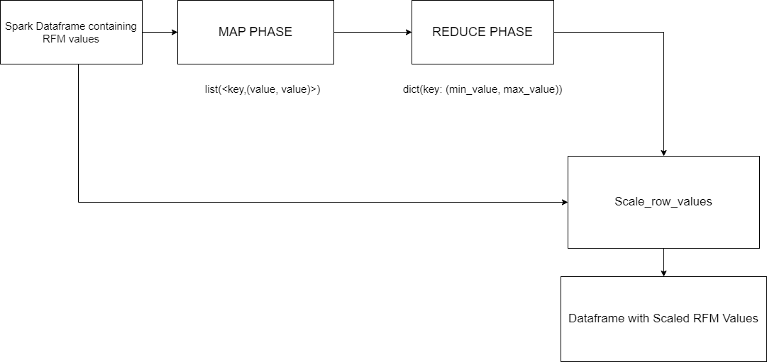
Numerical Data Scaling
We used a Map Reduce implementation of MinMaxScaler

Slide 34
Clustering using K-means
We used a Map Reduce implementation of K-means

Slide 35
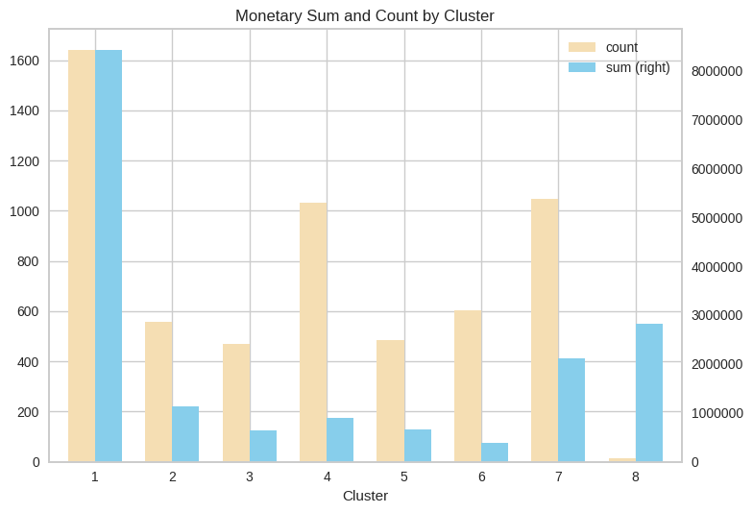
Clustering using K-means
We used a Map Reduce implementation of K-means

